Slide 1
Some Design Idea of
Red5 Clustering
Scalable
  Server’s capacity is enlarged when more hardwares are added
Failover
  Client will not notice the server node failures
Load-balancing
  Load is properly balanced among server cluster
Notes:
This foil explains the three clustering goal of Red5.

Slide 2
Various Clustering Configurations to Meet Various Usage Scenarios
Minimal Configuration and Quick Setup
  Experimental System or Testing System
  Play around
Large Concurrence with Medium Size Client Interaction
  Education System
Large Concurrence with Big Size Client Interaction
  Large Online Gaming
Notes:
We will provide three configurations that meet various usage scenarios while FMS only provides Edge/Origin solution without Origin clustering.

Slide 3
Technical Feasibility
Terracotta
  A Java Clustering Open Source Solution
  http://www.terracotta.org
  The TC team is now working with us to achieve the clustering goal of Red5.
Notes:
Terracotta is a famous and mature java clustering solution. It’s open source and free. We are working together with the Terracotta team to accomplish the goal of Red5 clustering.

Slide 4
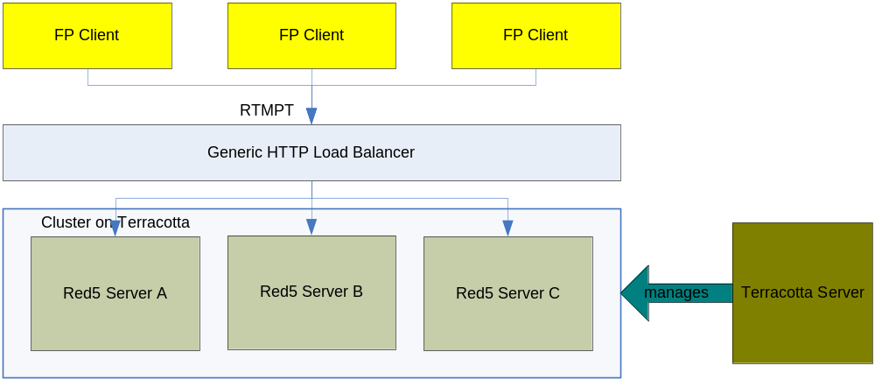
Minimal Configuration
Notes:
The minimal configuration is for quick server cluster setup. What you need is just pick a generic HTTP load balancer (Hardware or software) and configure the Red5 server to run on Terracotta.
The Terracotta Server is used to manage the Terracotta cluster.

Slide 5
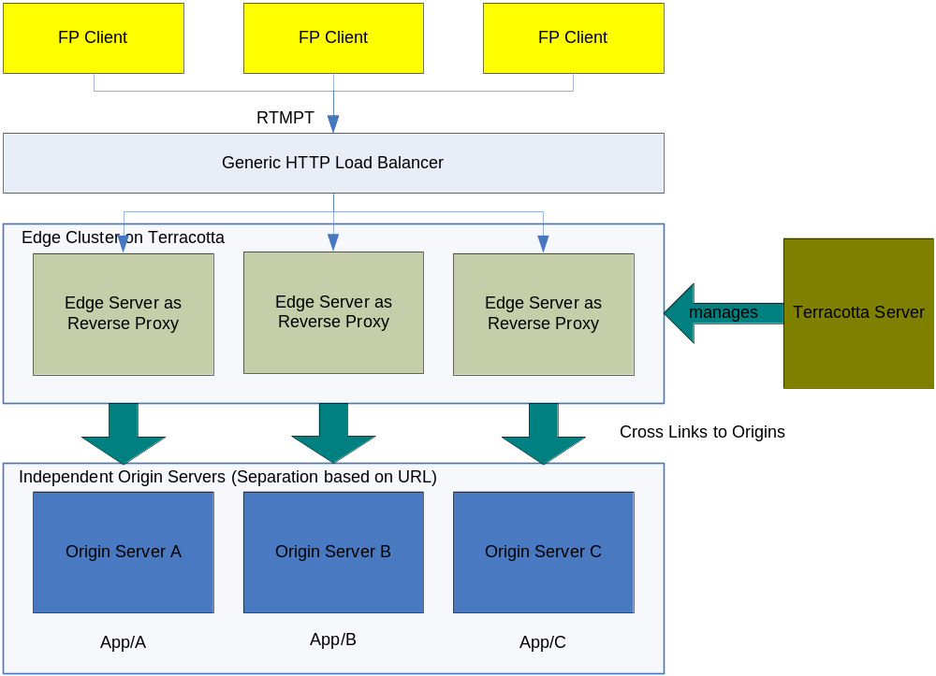
Large Concurrence with Medium Size Client Interaction
Notes:
This framework can support a large amount of concurrent connections with the medium size client interaction (which means the amount of connections that share a RSO or join in a Live conference is not very big).
Edge Server is used to manage connections. The actual requests from client will be multiplexed and forwarded to Origin Server in which the requests are actually served.
The Edge Servers run on Terracotta and clustered while Origin Server runs separately. The request is balanced per URL patterns. So different applications can run on different Origin Servers, or different sub-functions in one application can run on different Origin Servers (thus load-balancing is achieved).
Eg., for a Live conference application, say the URL is at App/Lobby/Room1, the Edge Server will route the request to a specific Origin, thus the conference is held on that Origin.

Slide 6
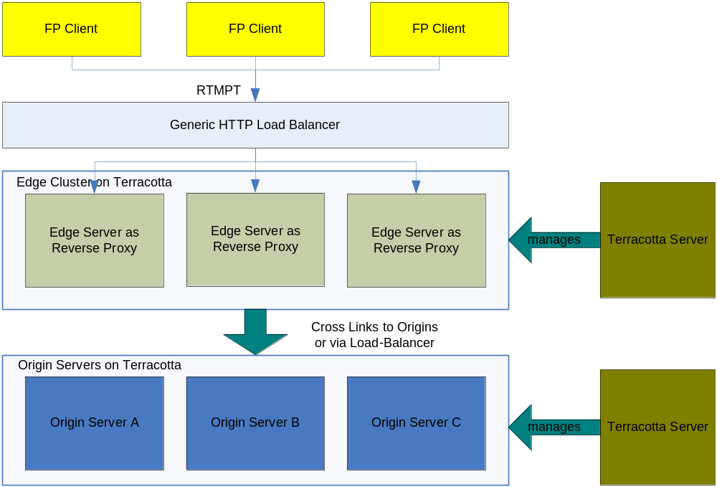
Large Concurrence with Big Size Client Interaction
Notes:
If the concurrent interaction requirement is mandatory, say in a big online gaming where the amount of concurrent connections that connect to the same RSO is large, a Origin Server clustering solution is needed.
The diagram above is different from the last diagram in that the Origin Servers run on Terracotta so that a specific RSO can be shared across the cluster.
The link between Edge and Origin could be cross link or a load-balancer. The load-balancer is preferred as in this case there should be no difference to connect Origin Server A or Origin Server B.

